Slide 1

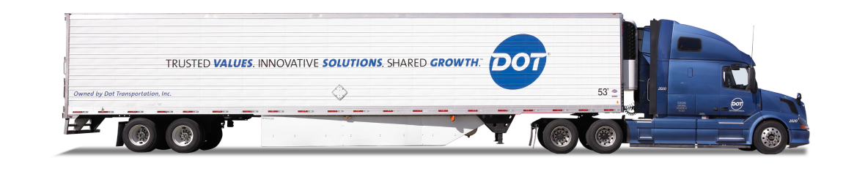
DOT FOODS
Project Proposal

Slide 2

AGENDA
01
INTRODUCTION
02
PROBLEM STATEMENT
03
WORKFLOW
04
DASHBOARD DESIGNS
05
DATA INSIGHTS
06
FEEDBACK

Slide 3
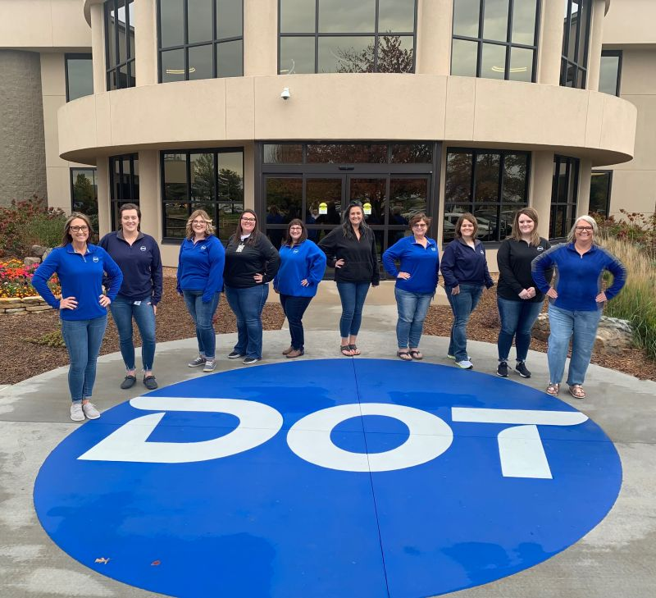
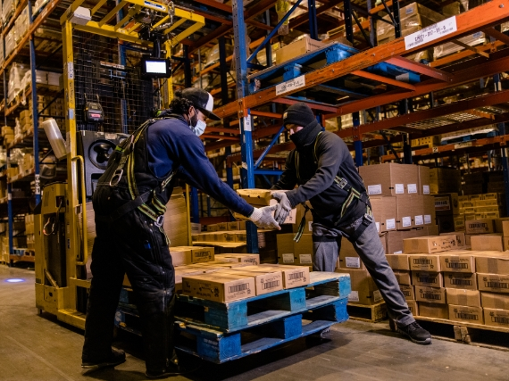
INTRODUCTION
Dot Foods aims to enhance its sales strategy by leveraging data-driven insights.
Sales reps need a 360° customer view for effective engagement.
Current challenges include manual data lookups, inconsistent customer segmentation, and lack of predictive insights.

Slide 4





PROBLEM STATEMENT
PROBLEM 2
Efficient Identification of Top-Performing and Low-Performing Customers
A key challenge is efficiently identifying top-performing and low-performing customers based on sales volume, transaction frequency, and utilization ratios. To address this, a customer segmentation model will classify clients dynamically, enabling proactive engagement strategies for sales representatives.
PROBLEM 1
Data-Driven Customer Segmentation and Sales Insight Enhancement
PROBLEM 3
Interactive Sales Tool for Real-Time Customer Insights
Dot Foods requires a data-driven solution to enhance customer segmentation, provide sales teams with real-time insights, and improve strategic decision-making. The current dataset needs to be processed for completeness, accuracy, and consistency, particularly in handling customer lookup formats and ensuring proper integration with machine learning models and visualization tools.
Additionally, an interactive sales tool will be developed to provide real-time access to customer insights. This tool will allow customer lookups by Ship No (handling leading zeros), dynamic tier comparisons, historical trend analysis, and load utilization tracking. By equipping sales reps with data-driven insights before client interactions, the solution will optimize customer relationship management and sales performance.

Slide 5
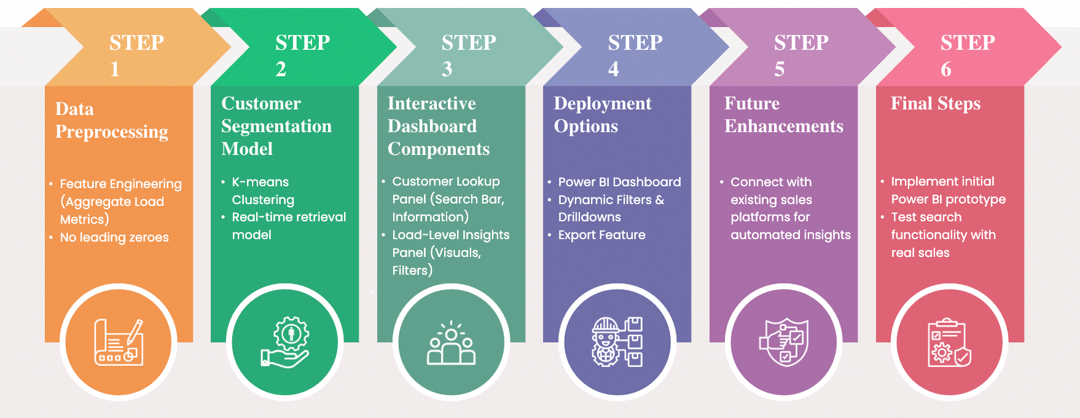
WORKFLOW- SALES ACCOUNT 360 TOOL

Slide 6
DATA INSIGHTS
SUMMARY
1. Weight:
Mean: 16,728
25th Percentile (Q1): 2,131
50th Percentile (Q2 or Median): 10,479
75th Percentile (Q3): 22,451
Explanation: Each row represents an individual order, and the weight indicates how much that specific order weighs. The 25th percentile means that 25% of the orders weigh less than 2,131 lbs. The 75th percentile tells us that 75% of the orders weigh less than 22,451 lbs, with larger orders likely appearing in the higher percentiles.
2. Cases:
Mean: 1,419
25th Percentile (Q1): 160
50th Percentile (Q2 or Median): 688
75th Percentile (Q3): 1,636
Explanation: The cases field indicates the number of packaged units in each order. The 25% of orders with fewer than 160 cases are likely smaller orders, while the top 25% of orders are significantly larger, with 1,636 or more cases. This shows that some companies place large orders in terms of units.
3. Lines:
Mean: 93.94
25th Percentile (Q1): 31
50th Percentile (Q2 or Median): 72
75th Percentile (Q3): 120
Explanation: The lines field represents the number of distinct products (or SKUs) in each order. A low number of lines (e.g., 31) suggests that an order contains fewer product types, while a higher number of lines (e.g., 120) suggests a greater variety of products. This helps understand the complexity of each order.
4. Pallets:
Mean: 9.52
25th Percentile (Q1): 3
50th Percentile (Q2 or Median): 7
75th Percentile (Q3): 13
Explanation: The pallets field reflects how much physical space the order occupies. A large number of pallets suggests that the order is bulkier and requires more storage space. Smaller orders may involve fewer pallets, while larger ones require more pallets for handling.

Slide 7
DATA INSIGHTS
SUMMARY
5. Cases/Line:
Mean: 39.77
25th Percentile (Q1): 10.16
50th Percentile (Q2 or Median): 24.86
75th Percentile (Q3): 53.06
Explanation: Cases/Line shows the average number of cases per distinct product (line) in an order. Higher values of cases/line suggest bulk ordering of a few product types, whereas lower values suggest more variety with smaller quantities of each product. This helps identify whether customers are purchasing a few products in large quantities or many products in smaller quantities.
6. PO Count:
Mean: 5.06
25th Percentile (Q1): 2
50th Percentile (Q2 or Median): 4
75th Percentile (Q3): 8
Explanation: PO Count indicates how many purchase orders are associated with each entry (order). A higher PO count typically means more fragmented orders, whereas a lower PO count suggests larger consolidated orders. This can reflect customer ordering behavior—whether they prefer placing a few large orders or many smaller ones.
7. Item Spread:
Mean: 0.065
25th Percentile (Q1): 0.02
50th Percentile (Q2 or Median): 0.05
75th Percentile (Q3): 0.10
Explanation: Item Spread indicates how diverse the product selection is in an order. A low item spread (close to 0) means the order contains fewer product types, while a higher value (close to 1) means the order contains many different products. This shows the diversity of the order, with higher item spread indicating more complex, varied orders.
8. Dock Time (Hours):
Mean: 2.85 hours
25th Percentile (Q1): 1.05 hours
50th Percentile (Q2 or Median): 2.34 hours
75th Percentile (Q3): 4.14 hours
Explanation: Dock Time shows how long it takes to process an order at the dock. Orders with longer dock times may be more complex, involve larger quantities, or require more handling. The range from 1.05 hours to 4.14 hours reflects the variability in how quickly orders are processed, with larger or more complex orders typically taking longer to handle.

Slide 8
DATA INSIGHTS
SUMMARY
Overall Data Distribution Insights:
Variation in Order Size: Orders vary significantly in terms of weight, cases, and lines, indicating that the dataset contains both small and large orders, with significant differences in order size across different companies and tiers.
High Variation in Processing Time: The dock time also shows a high degree of variability, suggesting that some orders require more time to process due to size or complexity.
Complexity and Variety: Orders with high item spread and cases/line indicate that some customers place large, diverse orders, while others may have more specialized, bulk-focused orders.
Consolidation vs Fragmentation: The PO count distribution suggests that many orders are consolidated, but some customers place fragmented, smaller orders across multiple purchase orders.

Slide 9
DATA INSIGHTS
Improvement Plan
Tier
Specific Company
State
Order Frequency Per Company

Slide 10

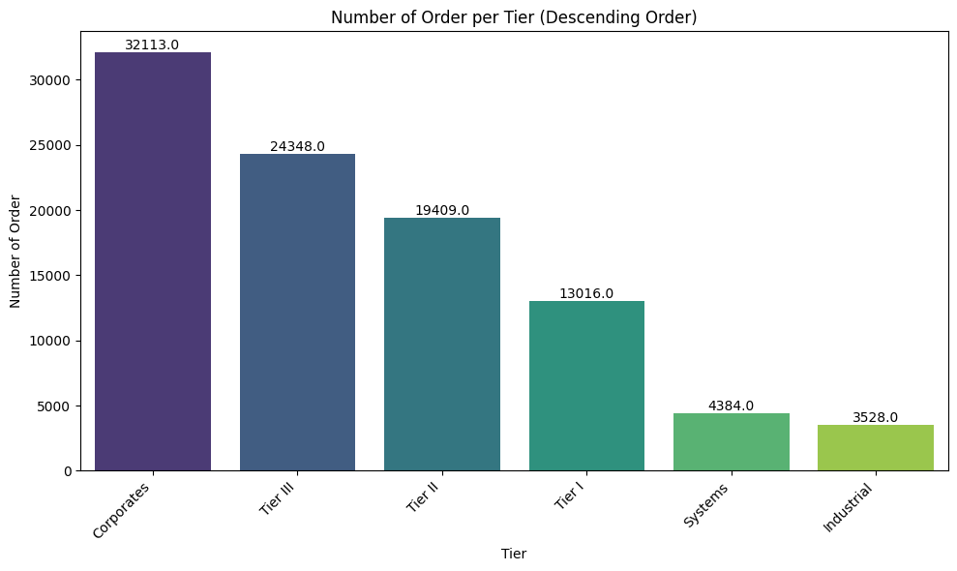

DATA INSIGHTS
Most Frequent Order Per Tier

Slide 11
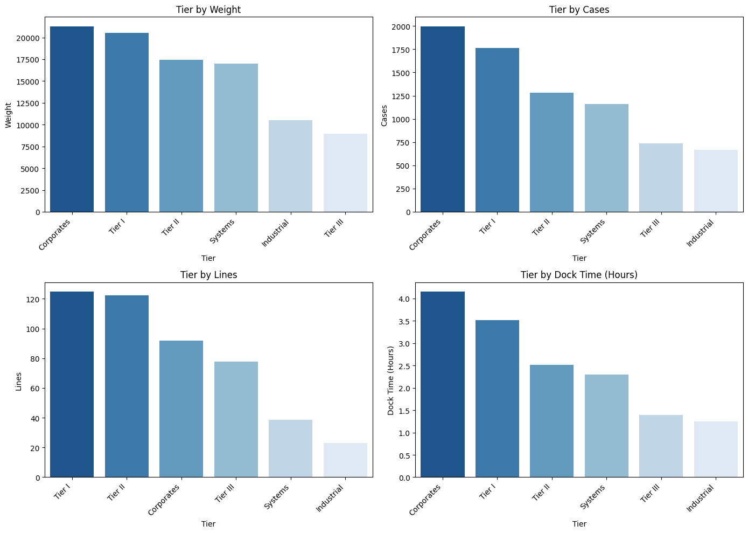
DATA INSIGHTS
Tier Characteristic per Measure

Slide 12
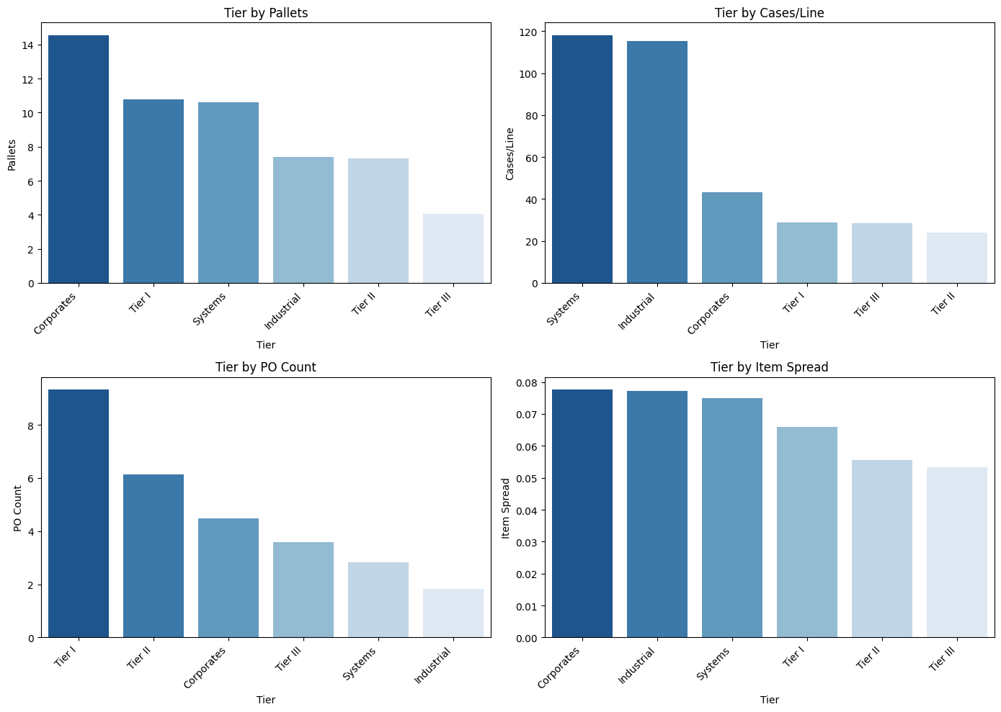
DATA INSIGHTS
Tier Characteristic per Measure

Slide 13
DATA INSIGHTS
SUMMARY
1. Corporates
Order Volume: Corporates have the highest number of orders (32,113) by a significant margin compared to other tiers.
Weight: The weight of orders from Corporates is also the highest, indicating large shipments.
Cases: Corporates have the highest number of cases ordered, which further supports the high volume of their orders.
Lines: They have fewer product lines compared to Tier I and Tier II, which suggests bulkier orders with fewer types of products.
Dock Time: The dock time is the longest, possibly due to the large orders requiring more handling time.
Pallets: They have the largest number of pallets, indicating the physical volume of their shipments.
Cases/Line: Corporates have a relatively low cases/line, suggesting that while they order large quantities, they don't diversify as much across product types.
PO Count: They have a moderate PO count, indicating that they may order in larger, consolidated shipments.
Item Spread: They have a low item spread, indicating fewer different types of products in their orders.

Slide 14
DATA INSIGHTS
SUMMARY
2. Tier I
Order Volume: Tier I customers have the second-highest number of orders (19,409).
Weight: Their order weight is high, similar to Corporates, suggesting they tend to place heavy orders.
Cases: Tier I customers also order a significant number of cases, but not as many as Corporates.
Lines: They have a higher number of lines than Corporates, indicating more product diversity in their orders.
Dock Time: Tier I has high dock time, indicating that their orders are large and require more time to process.
Pallets: They order a large number of pallets, similar to Corporates.
Cases/Line: Tier I has moderate cases/line, meaning their orders are somewhat balanced between volume and variety.
PO Count: Tier I customers have a moderate PO count.
Item Spread: They have a moderate item spread, indicating that their orders contain a wider variety of products than Corporates.

Slide 15
DATA INSIGHTS
SUMMARY
3. Tier II
Order Volume: Tier II customers have the third-highest number of orders (13,016).
Weight: The weight of Tier II orders is moderate, lower than Tier I but still significant.
Cases: Tier II customers order a substantial number of cases, but fewer than Tier I.
Lines: The number of lines ordered is higher than Corporates, similar to Tier I, indicating a diversified product selection.
Dock Time: Tier II has moderate dock time, longer than Systems or Industrial but shorter than Corporates and Tier I.
Pallets: Tier II orders a moderate number of pallets.
Cases/Line: The cases/line is lower for Tier II, suggesting they order a wider range of products with moderate quantities.
PO Count: Tier II customers have a moderate PO count, similar to Tier I.
Item Spread: Tier II customers have a moderate item spread, indicating they order a mix of products but not as much as the lower-tier groups.

Slide 16
DATA INSIGHTS
SUMMARY
4. Tier III
Order Volume: Tier III customers have fewer orders (24,348) than the higher tiers, but still represent a significant portion of the order volume.
Weight: The weight of their orders is also moderate but lower than the higher tiers.
Cases: Tier III orders fewer cases compared to higher tiers.
Lines: They have fewer lines, indicating less product diversity in their orders.
Dock Time: Their dock time is lower than Tier I and Tier II, but still significant for handling medium-sized orders.
Pallets: Tier III customers order fewer pallets compared to the higher tiers.
Cases/Line: The cases/line is moderate, indicating a balance between volume and variety.
PO Count: Tier III has a higher PO count, suggesting that orders are more frequent but might be of smaller size or more fragmented.
Item Spread: Tier III has a higher item spread, indicating that they order a wider variety of products with smaller quantities.

Slide 17
DATA INSIGHTS
SUMMARY
5. Systems
Order Volume: Systems customers place the smallest number of orders (4,384), indicating they might be niche customers with fewer, more specific needs.
Weight: Their orders are lighter, as shown by the lower weight.
Cases: Systems orders fewer cases, aligning with their lighter shipments.
Lines: They have fewer lines, which indicates they likely order fewer types of products.
Dock Time: Their dock time is relatively low, suggesting faster order processing.
Pallets: Systems orders a moderate number of pallets.
Cases/Line: Systems have the highest cases/line, suggesting they order larger quantities of fewer products.
PO Count: Systems customers have a lower PO count, indicating that their orders are likely larger and consolidated.
Item Spread: They have a lower item spread, meaning they focus more on a few key products.

Slide 18
DATA INSIGHTS
SUMMARY
6. Industrial
Order Volume: Industrial customers also have relatively few orders (3,528).
Weight: Their order weight is on the lower end, but still notable for this tier.
Cases: Industrial orders a small number of cases compared to other tiers.
Lines: They have fewer lines than other tiers, indicating less product variety in their orders.
Dock Time: Their dock time is the shortest, suggesting their orders are processed more quickly.
Pallets: Industrial has fewer pallets compared to higher tiers.
Cases/Line: Their cases/line is moderate, similar to Tier II, but higher than Tier III and Corporates.
PO Count: Industrial has a moderate PO count, which may reflect smaller, more frequent orders.
Item Spread: Industrial customers have a moderate item spread, similar to Tier II and Tier III.

Slide 19
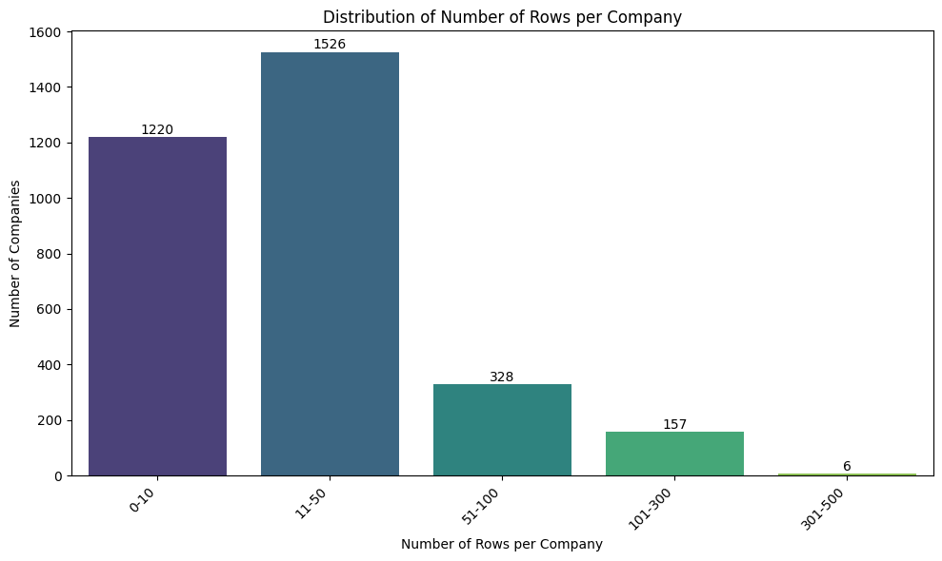
DATA INSIGHTS
Number of Order per Company

Slide 20
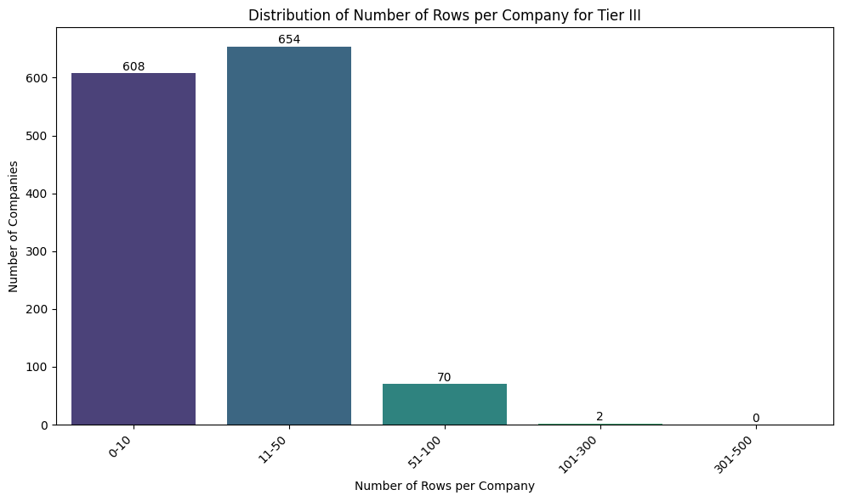
DATA INSIGHTS
Example Number of Order per Company(Tier III)

Slide 21
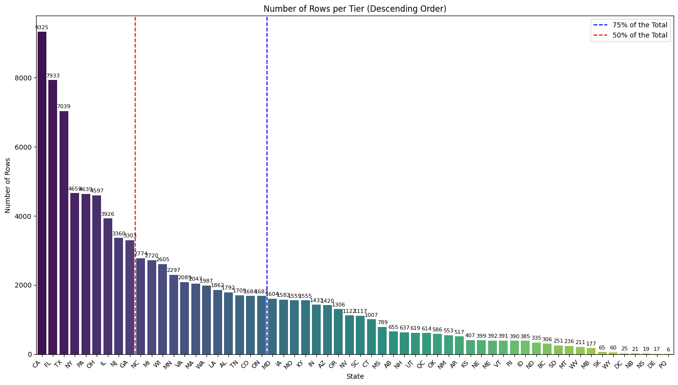
DATA INSIGHTS
Number of Orders in Each State

Slide 22
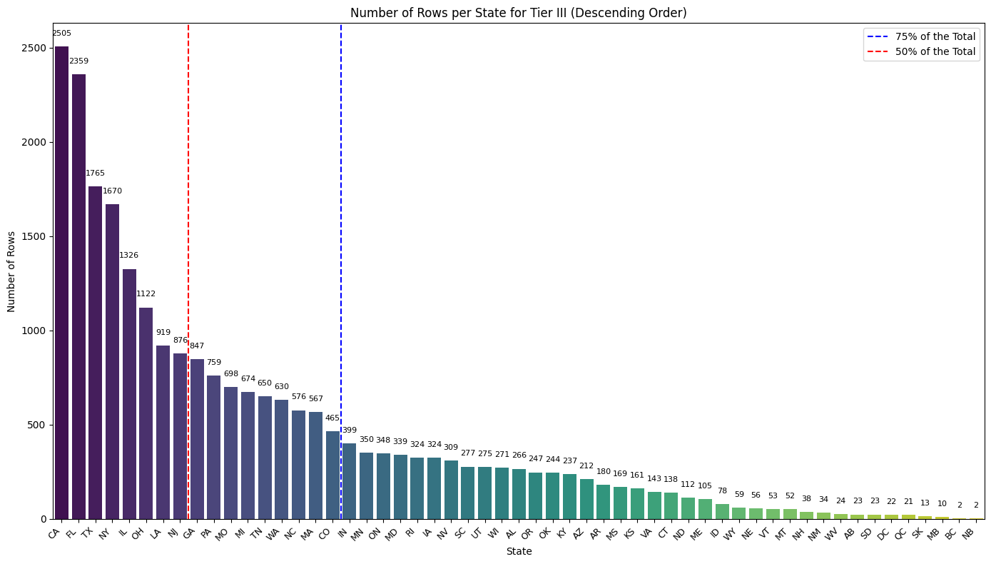
DATA INSIGHTS
Example of Number of Orders in Each State(Tier III)

Slide 23
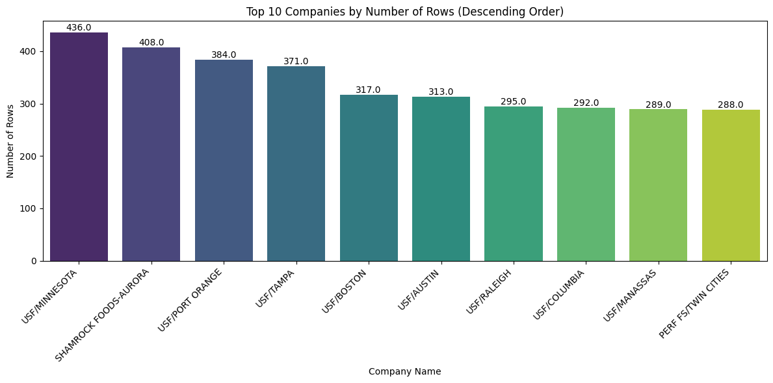
DATA INSIGHTS
Companies with most frequent Orders

Slide 24
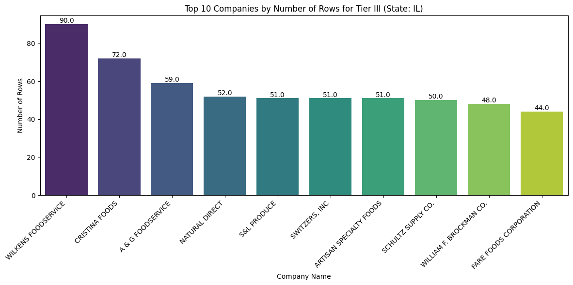
DATA INSIGHTS
Example Companies with most frequent Orders(Tier III and Illinois)

Slide 25
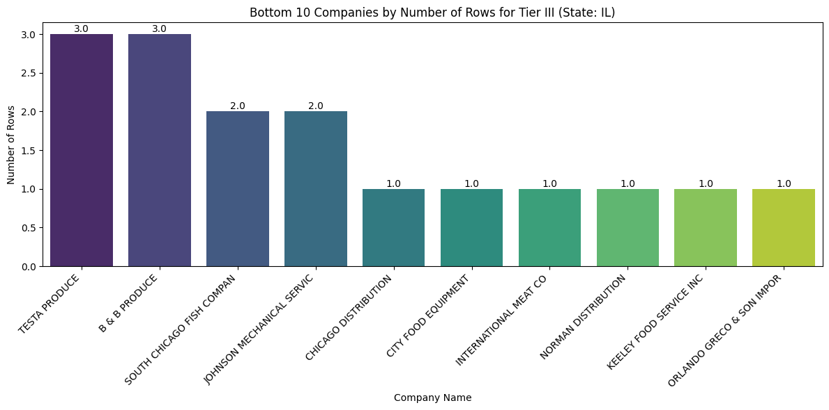
DATA INSIGHTS
Example Companies with least frequent Orders(Tier III and Illinois)

Slide 26
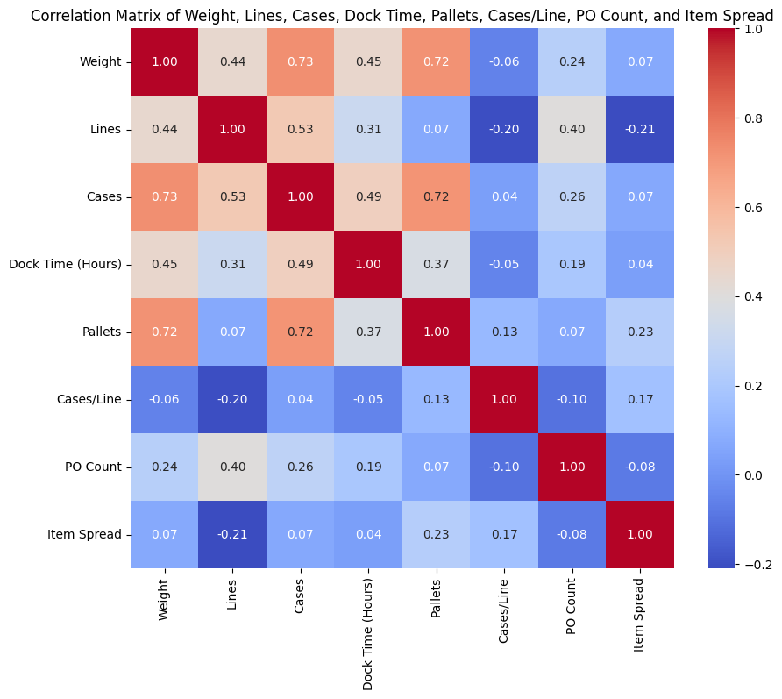
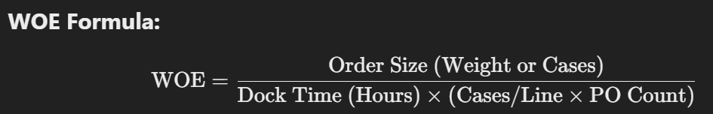
COMPANIES TO FOCUS
We can do this by creating a new Measure. Based on each metric correlation
WOE (Weighted Order Efficiency) is a performance measure designed to assess how efficiently an order is processed, considering the order size, dock time, and order complexity. It takes into account the amount of product (weight or cases) processed per unit of dock time while factoring in the complexity of the order (through cases per line and PO count).
Order Size: Measures the total volume of the order (either by weight or cases).
Dock Time: Represents the time taken to process the order at the dock.
Cases/Line and PO Count: Reflects the complexity of the order (e.g., more product types or purchase orders mean higher complexity).

Slide 27
COMPANIES TO FOCUS
We can do this by creating a new Measure. Based on each metric correlation
Why Use WOE?
Efficiency Insight: WOE balances order size with processing time and complexity, offering a clear indication of how effectively resources (time and labor) are utilized to process orders.
Identifies Bottlenecks: By factoring in both order size and complexity, WOE helps pinpoint inefficiencies in processing, especially for large or complex orders.
Actionable Metrics: The measure helps identify areas where resource allocation or logistics operations can be optimized to reduce dock time and improve overall processing efficiency.
Performance Comparison: WOE can be used to compare the efficiency of different orders, customers, or time periods, providing insights into where improvements can be made to streamline operations.

Slide 28
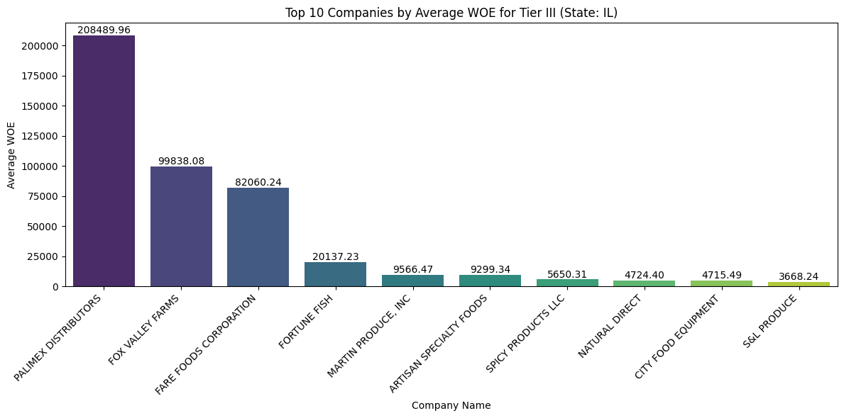
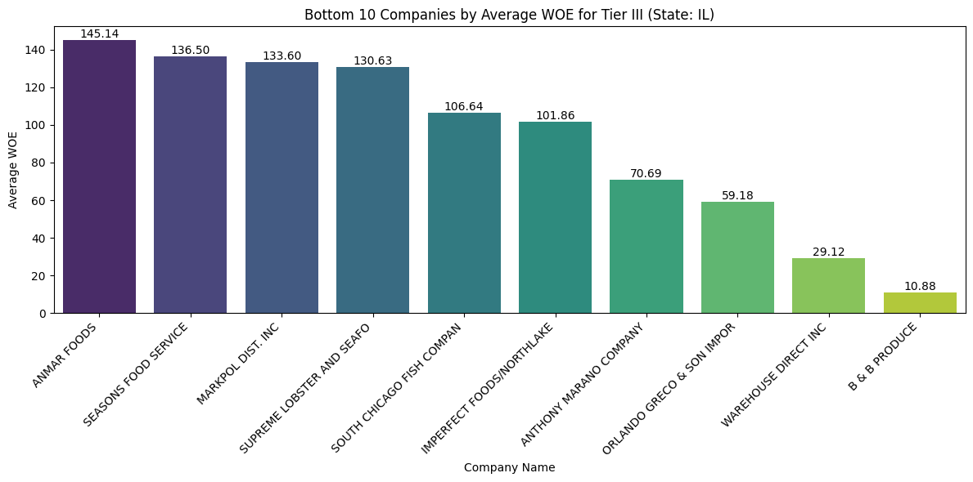
COMPANIES TO FOCUS
Top 10 and Bottom 10 Companies in Illinois and Tier III Based on WOE

Slide 29
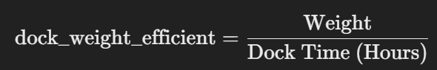
COMPANIES TO FOCUS
More Simple New Measure, Weight per Dock Hours
Low dock weight efficiency could result from factors such as inefficient docking processes, long unloading times, high product complexity (e.g., requiring special handling or packing), or underutilized equipment. It’s worth analyzing the specific steps in the dock operations and looking for bottlenecks or areas for automation.
Q: How can I use dock weight efficiency to optimize warehouse operations? A: You can use dock weight efficiency to identify areas where manual labor or equipment usage is underperforming. By identifying low efficiency, you can optimize processes such as product handling, dock layout, or even staffing levels to reduce dock time and increase throughput. Additionally, automated systems can be introduced to reduce inefficiencies.

Slide 30
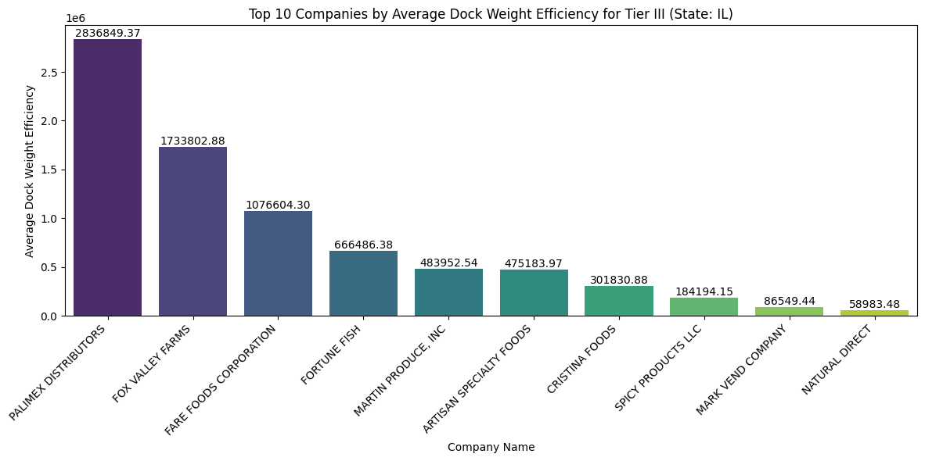
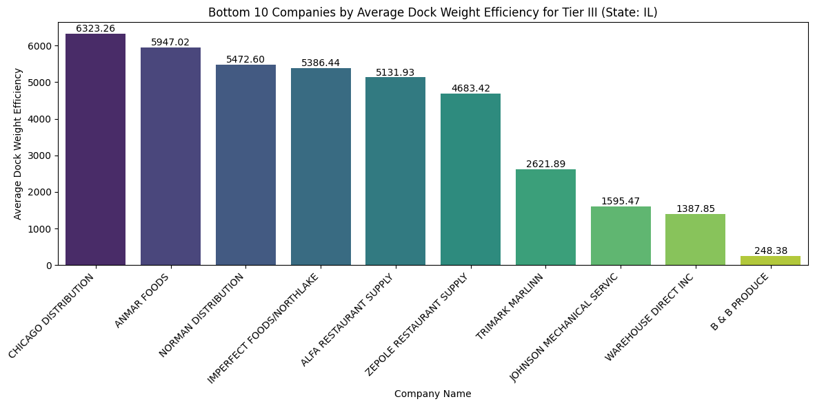
COMPANIES TO FOCUS
We can do this by creating a new Measure. Based on each metric correlation

Slide 31
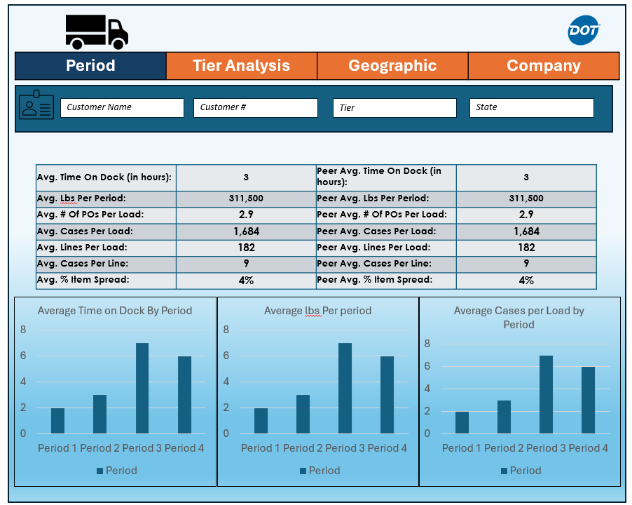
DASHBOARD DESIGNS
SAMPLE DASHBOARD IDEAS

Slide 32
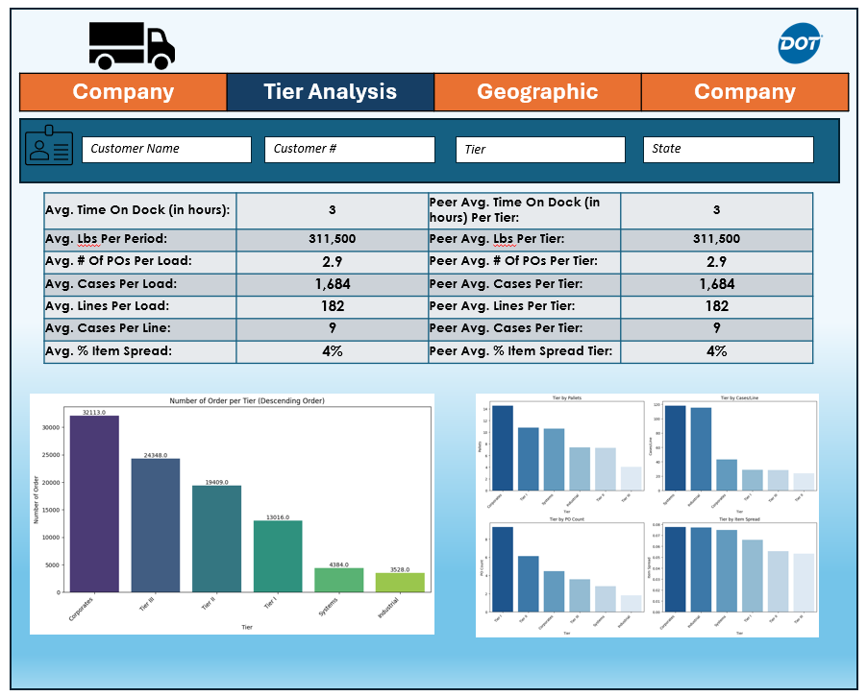
DASHBOARD DESIGNS
SAMPLE DASHBOARD IDEAS

Slide 33
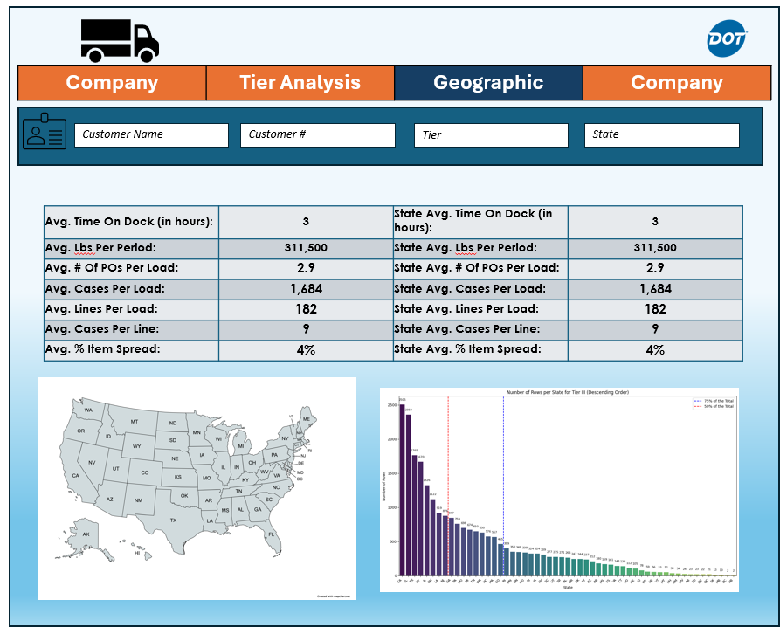
DASHBOARD DESIGNS
SAMPLE DASHBOARD IDEAS

Slide 34
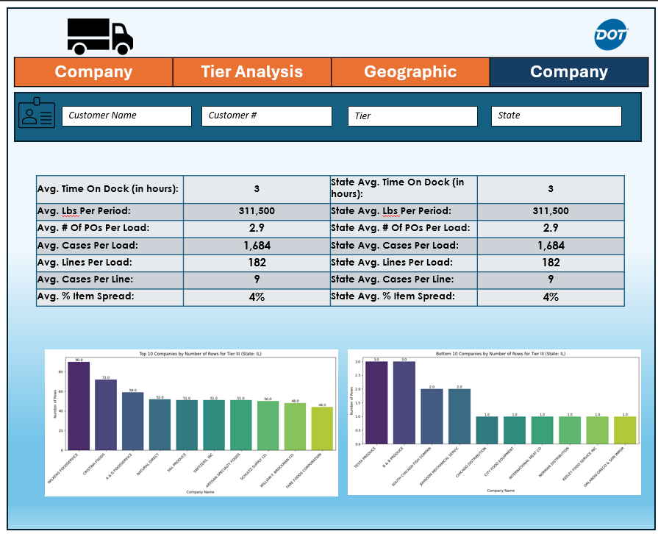
DASHBOARD DESIGNS
SAMPLE DASHBOARD IDEAS

Slide 35


DOT FOODS
FEEDBACK

Slide 36



THANK'S FOR WATCHING
DOT FOODS

